Slide 1
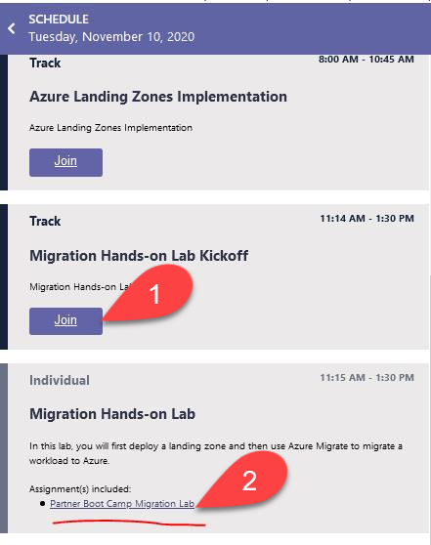
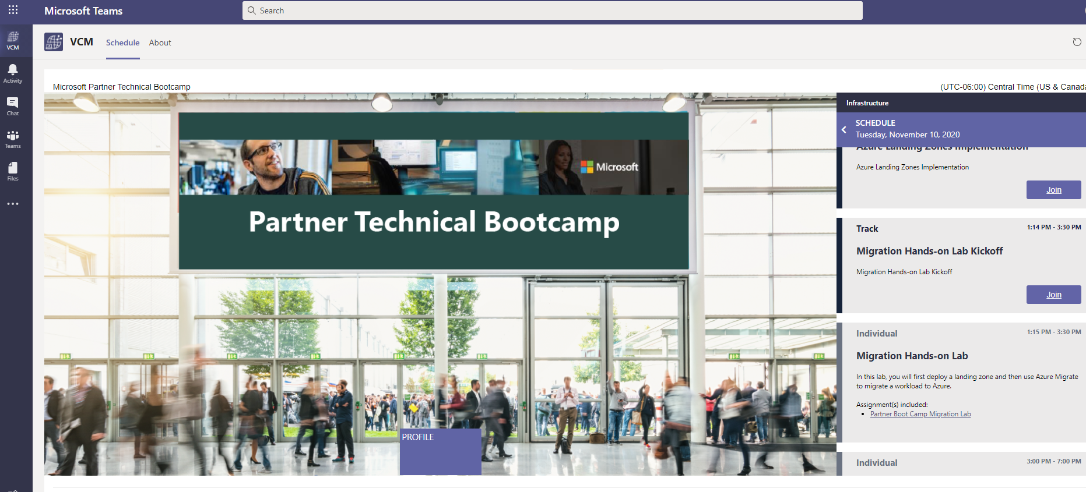
Hands On Lab link in VCM
Notes:
Go back to the main VCM screen and go to the Migration Hands-on Lab
Click the Partner Boot Camp Migration Lab
Once the page for the Migration Lab is up, click the Lab Environment link

Slide 2
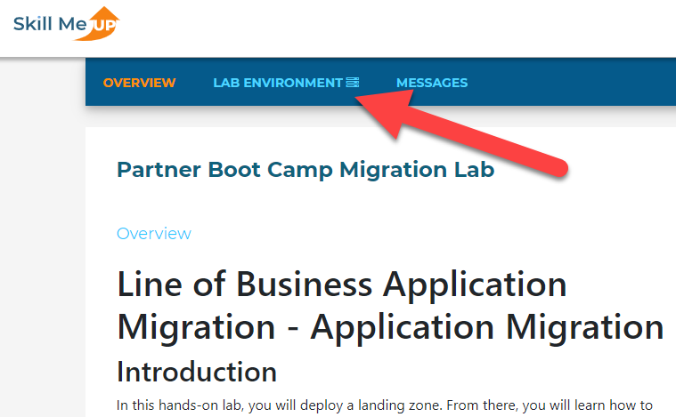
Hands On Lab on SkillMeUp
Notes:
Once the page for the Migration Lab is up, click the Lab Environment link at the top

Slide 3
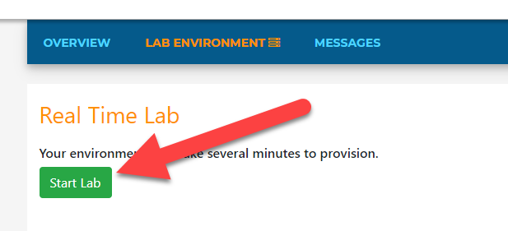
Start the Lab
Notes:
Once the page for the Migration Lab is up, click the Lab Environment link at the top

Slide 4
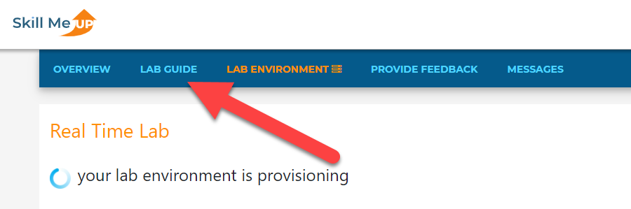
Access Lab Guide
Notes:
Once the page for the Migration Lab is up, click the Lab Environment link at the top

Slide 5
Access Lab Guide
Notes:
Once the page for the Migration Lab is up, click the Lab Environment link at the top

Slide 6
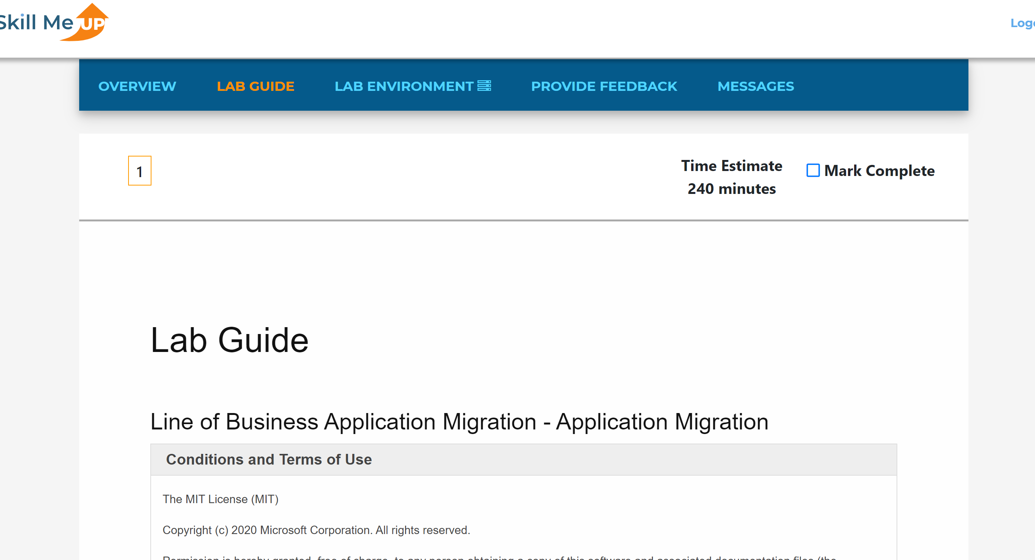
Lab Guide
Notes:
Once the page for the Migration Lab is up, click the Lab Environment link at the top

Slide 7
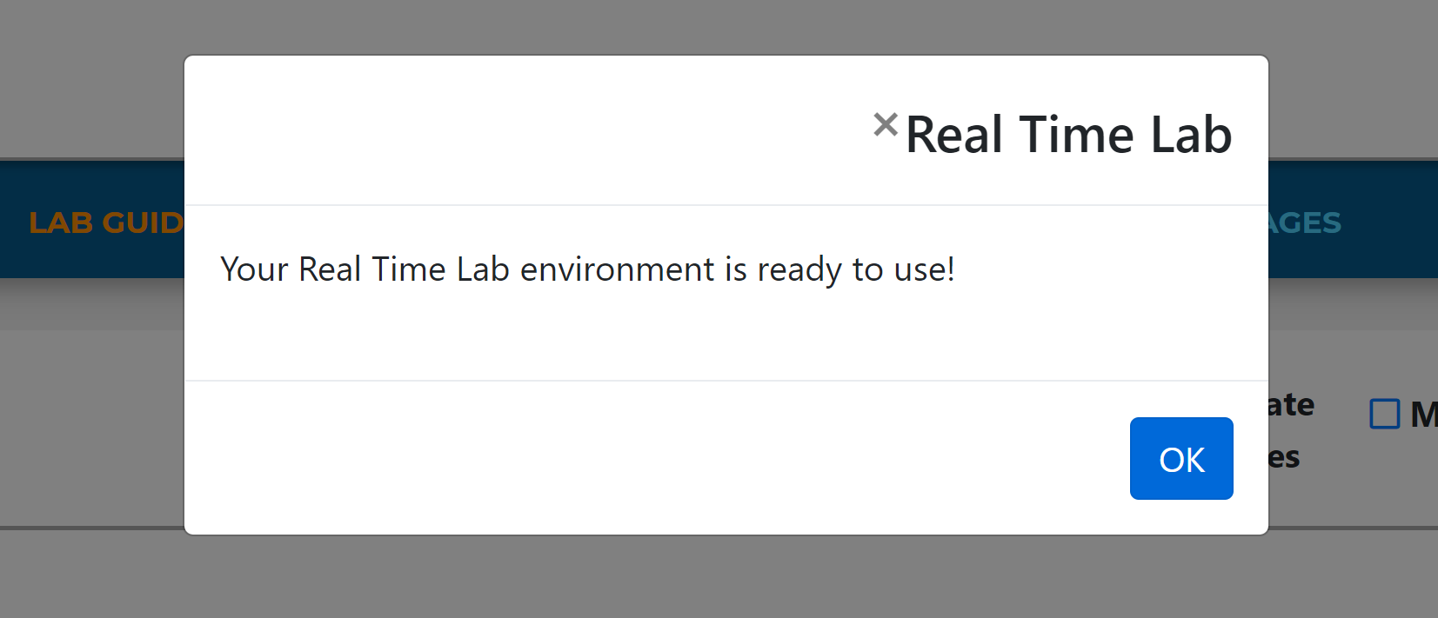
Lab Ready
Notes:
Once the page for the Migration Lab is up, click the Lab Environment link at the top

Slide 8
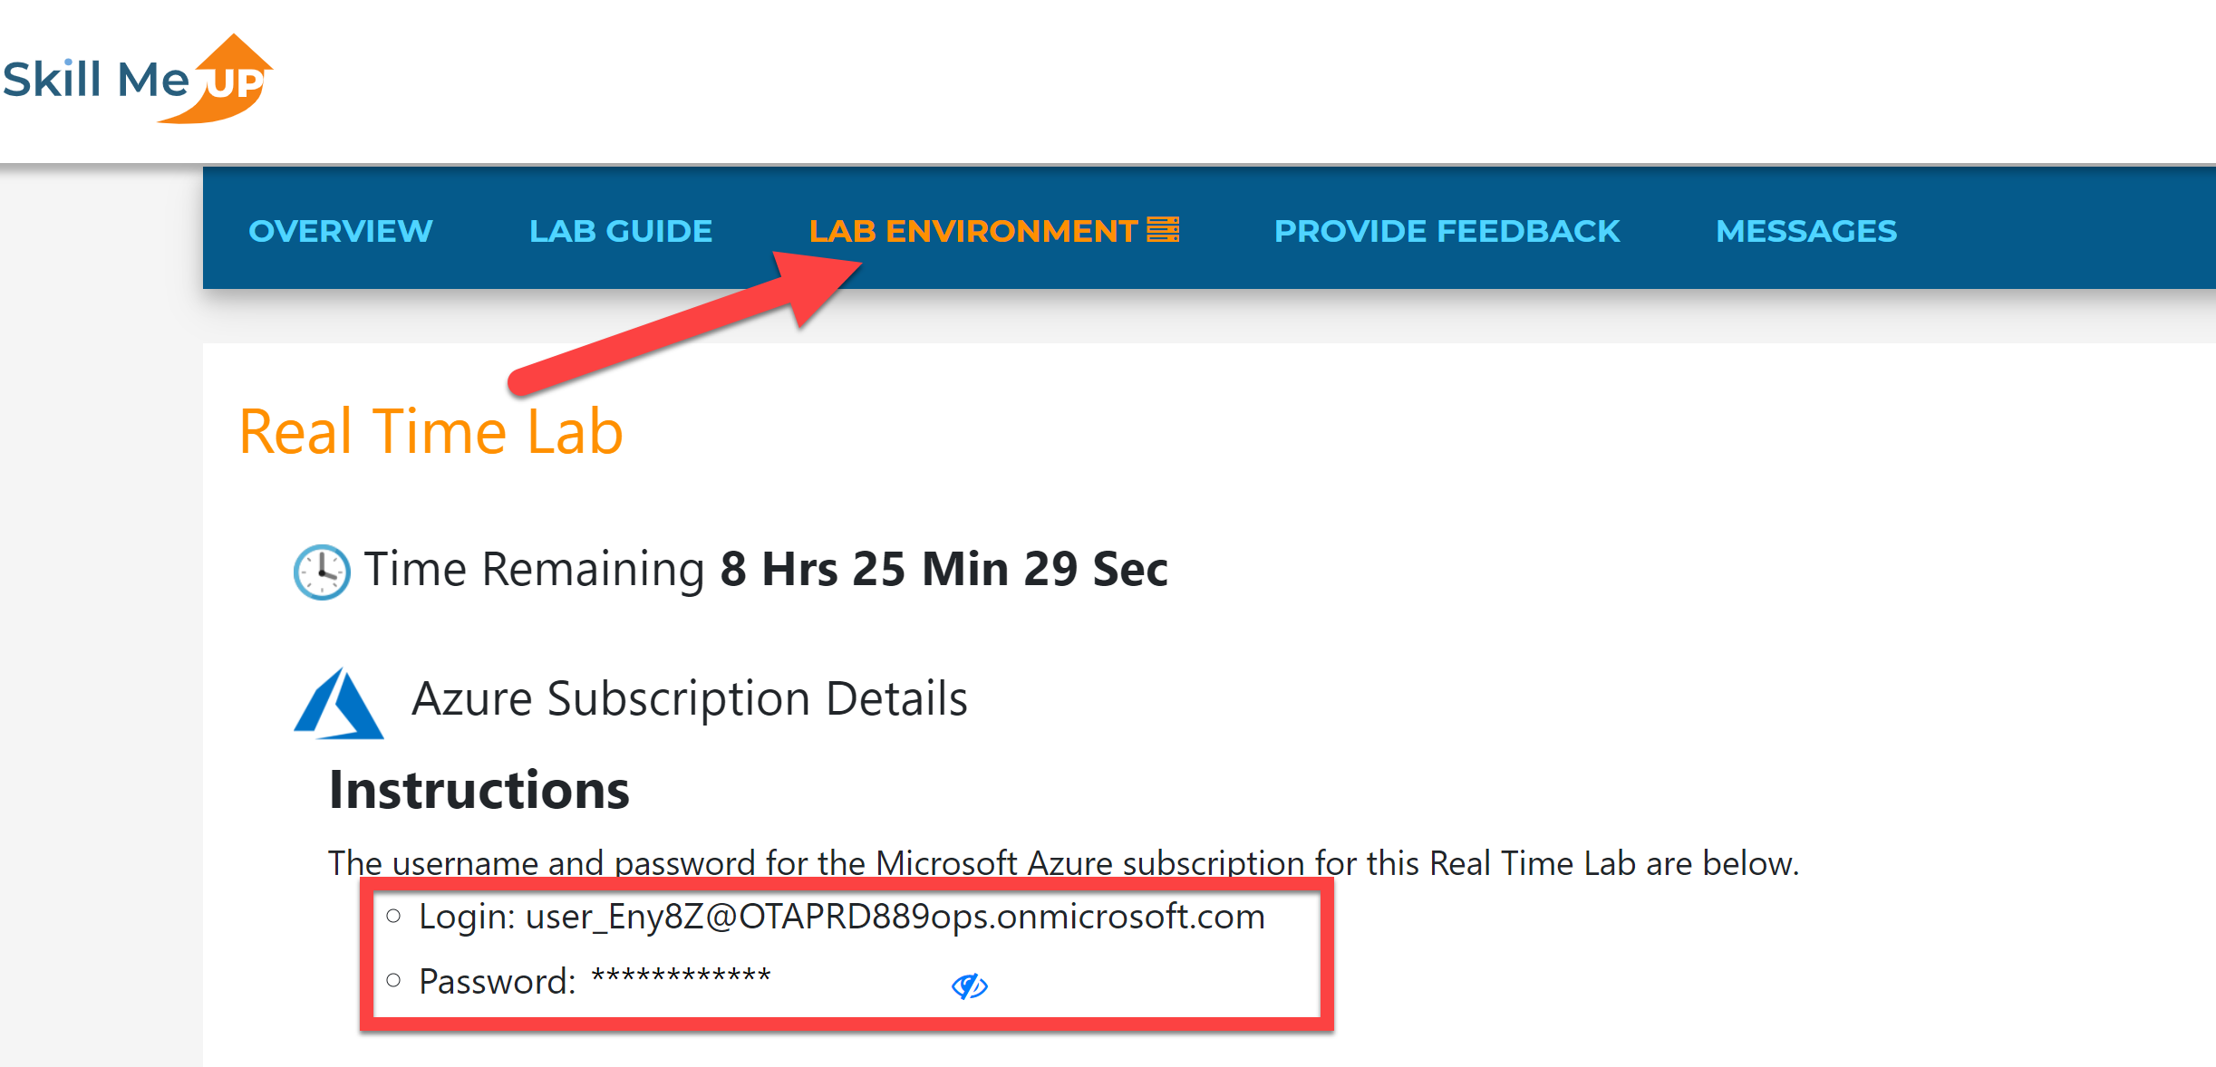
Lab Ready
Notes:
Once the page for the Migration Lab is up, click the Lab Environment link at the top

Slide 9
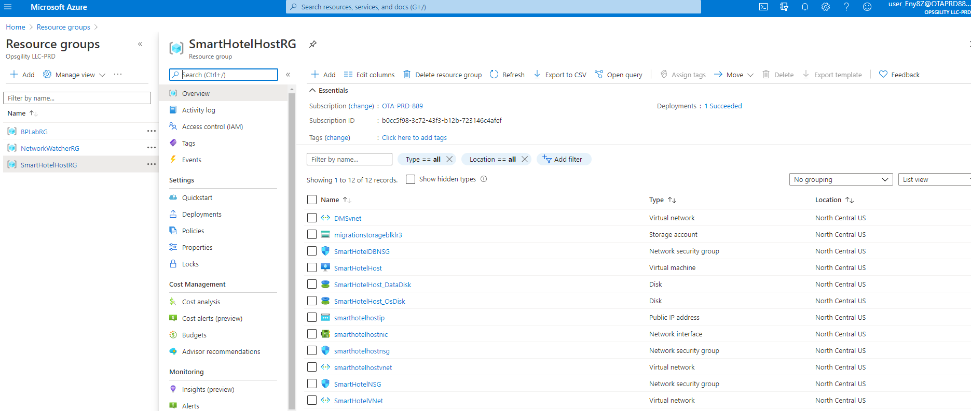
Azure Portal
Notes:
Once the page for the Migration Lab is up, click the Lab Environment link at the top

